Slide 1

Framework

Slide 2

Composer
Composer – PHP tili uchun bog'liqliklar menejeri (Dependency Manager) (consol orqali ishlaydi)
https://getcomposer.org/
Bog'liqlik – web-ilova imkoniyatini kengaytiruvchi kutubxona, paket.
https://packagist.org/
Nega composer?
1. Bir qator orqali o'rnatish, sozlash, yangi versiyasiga o'tkazish
2. Bir kutubxona uchun zarur boshqa kutubxonalarni avtomatik o'rnatish
3. Kutubxonalar hajmi katta bo'lganda ham serverga ko'chirish osonligi

Slide 3
Composer
Paketni o'rnatish: composer require vendor/package:version composer require "twig/twig:v2.0"
"composer.json" faylini yangilaydi, agar o'rnatilayotgan paket uchun boshqa kutubxonalar zarur bo'lsa ularni ham o'rnatadi va faylni yangilaydi, "composer.lock" fayli ham yangilanadi.
Loyihadagi barcha paketlarni o'rnatish: composer install
"composer.lock" fayli mavjudligini tekshiradi. Agar mavjud bo'lsa unda ko'rsatilgan versiyalarni o'rnatadi, aks holda "composer.json" faylida ko'rsatilgan bog'liqliklarni aniqlaydi va "composer.lock" faylini yaratadi, so'ngra ularni o'rnatadi.

Slide 4
Composer
Bog'liqliklarni yangilash: composer update
Bitta kutubxonani yangilash: composer update vendor/package
Loyihadan paketni o'chirish: composer remove vendor/package composer remove vendor/package vendor2/package2
Composerni yangilash: composer self-update
Yangi proektni yaratish: composer create-project vendor/package composer create-project vendor/package folder
Barcha o'rnatilgan kutubxonalarni ko'rish: composer show

Slide 5

CMS vs Framework
CMS – Content Management System
Wordpress
Joomla!
Drupal
OpenCart
Magento

Slide 6
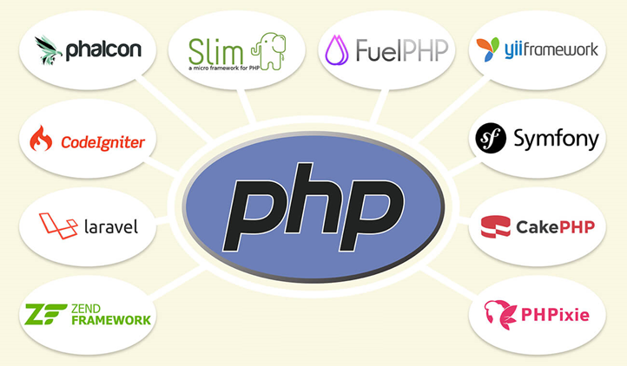
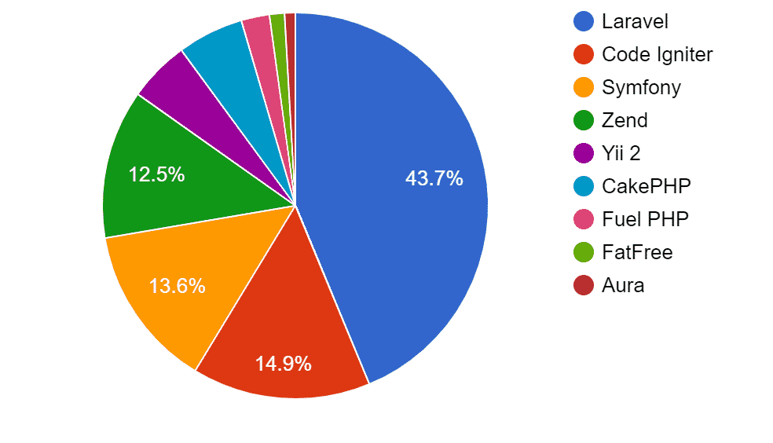
Framework

Slide 7
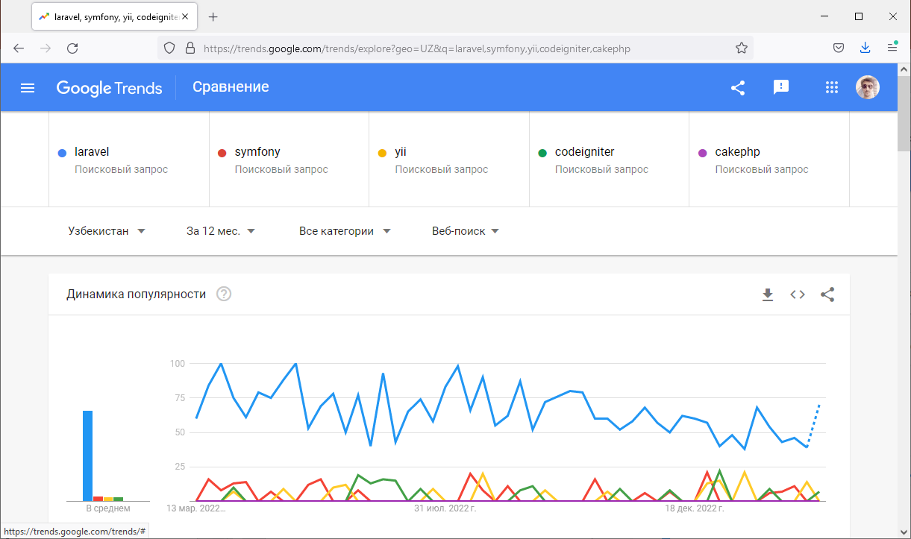
Framework
https://laravel.com/
https://symfony.com/
https://yiiframework.com/
https://codeigniter.com/

Slide 8
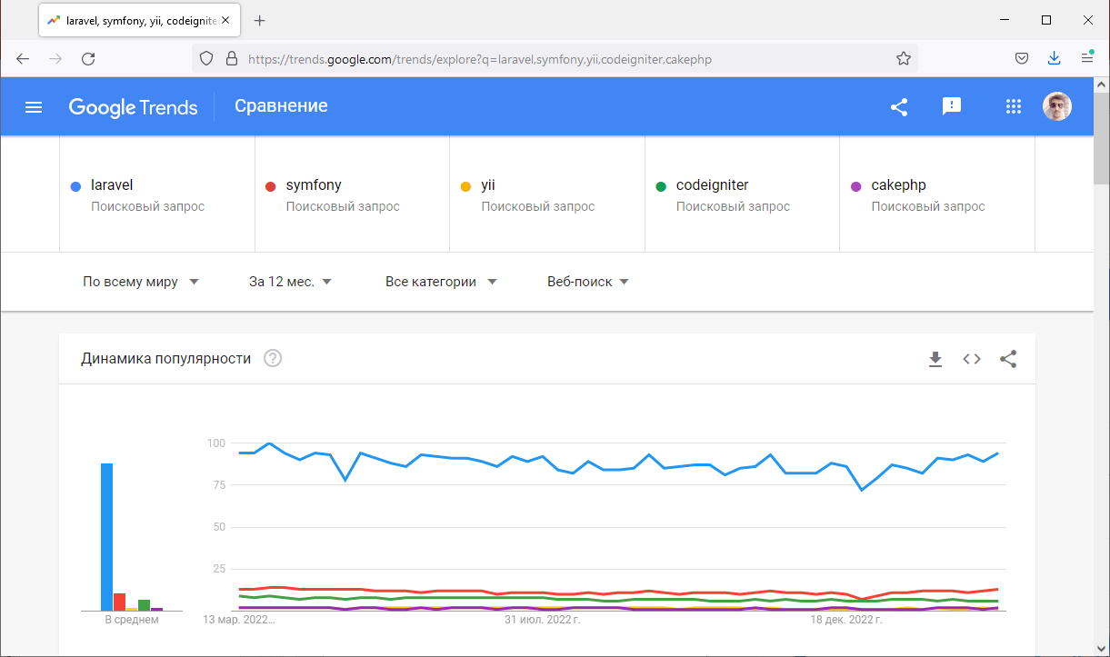
Framework
https://laravel.com/
https://symfony.com/
https://yiiframework.com/
https://codeigniter.com/

Slide 9
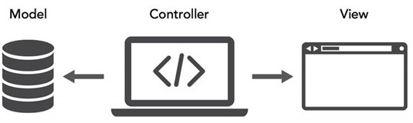

MVC
Model - View - Controller (MVC) – dasturiy ta'minot ishlab chiqish modeli (software design pattern).
Model – ilovaning foydalanuvchi interfeysiga bog'liq bo'lmagan dinamik berilganlar strukturasi. Asosiy vazifalaridan biri – berilganlarni boshqarish.
View – foydalanuvchiga berilganlarni ko'rsatish uchun xizmat qiladi.
Controller – model va view o'rtasidagi aloqa vositasi, foydalanuvchi buyruqlarini boshqarish va amalga oshirish uchun xizmat qiladi.
Controller
Send data
Data processing
View
Request
Model
Response

Slide 10
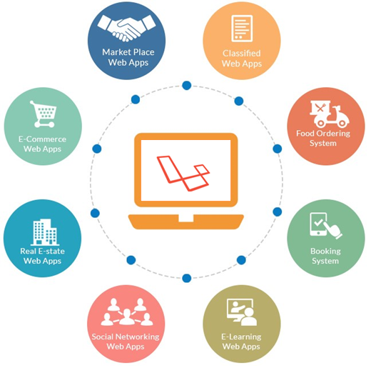
Laravel
Laravel – ochiq kodli, bepul web-framework.
Yaratuvchisi: Taylor Otwell
Oxirgi versiyasi: 10.x (16 fevral, 2023)
Web-site: https://laravel.com
Version | PHP (*) | Release
6 (LTS) | 7.2 - 8.0 | September 3rd, 2019
7 | 7.2 - 8.0 | March 3rd, 2020
8 | 7.3 - 8.1 | September 8th, 2020
9 | 8.0 - 8.2 | February 8th, 2022
10 | 8.1 - 8.2 | February 14th, 2023

Slide 11

Laravel
Laravel – ochiq kodli, bepul web-framework.
Yaratuvchisi: Taylor Otwell
Oxirgi versiyasi: 10.x.x (16 fevral, 2023)
Asosiy xossalari:
Packages (Composer)
Eloquent ORM, Query Builder
Database Migration
Authentication
Blade template engine
Artisan
Security
Multi-lingual
Unit testing

Slide 12
Laravelni o'rnatish
Laravel Installer orqali:
composer global require laravel/installer
laravel new example-app
php artisan key:generate
php artisan serve
Composer Create-Project orqali:
composer create-project laravel/laravel example-app
example-app – laravel o'rnatiladigan papka

Slide 13
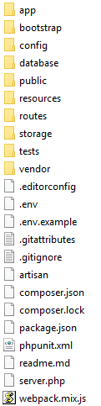
Laravel tarkibi
app – ilovaning asosiy kodlari joylashadigan papka
bootstrap – ilovaning yuklaydigan app.php fayli, shuningdek marshrutlash va turli xizmatlarning keshlarini o'z ichiga olgan papka
config – ilovaning konfiguryatsion fayllari joylashadigan papka
database – berilganlar bazasiga migratsiyalar (migrations), boshlang'ich to'ldirishlar (seeds) va feyk berilganlar bilan to'ldirishlar (factory) joylashadigan papka
public – ilovani ishga tushuruvchi asosiy papka, shuningdek js, css fayllar, rasmlar joylashgan papkalarni o'z ichiga olgan papka
resources – to'liq bo'lmagan, ilova ishlatiladigan resurs fayllarni o'z ichiga olgan papka (masalan lokalizatsiya fayllari, less sass fayllar, shablonlar va h.k.)
routes – url manzillarni, console buyruqlarni boshqaruvchi fayllar joylashgan papka
storage – ilova "omborxona"si, yuklangan fayllar, log, sessiya, kesh fayllar joylashgan papka
tests – testlash jarayoni kodlari saqlanadigan papka
vendor – composer bog'liqliklari (modullar) joylashadigan papka
lang – ilovada ishlatilishi mumkin bo'lgan matnlarning turli tillardagi tarjimalari fayllari
.env – muhit o'zgaruvchilari fayli
composer.json – composer bog'liqliklarni boshqaruvchi fayl

Slide 14
Artisan
Artisan – buyruqlar satri interfeysi. Ilova ishlab chiqishda yordam beradigan bir qancha buyruqlarni o'z ichiga olgan. Symfony Console komponentiga asoslanib ishlab chiqilgan.
Sintaksisi:
php artisan <buyruq> [<qo'shimcha parametrlar>]
php artisan list – mavjud buyruqlar ro'yxati
php artisan help migrate – migrate buyrug'i yordamchish
php artisan --version – Laravel versiyasini aniqlash buyrug'i

Slide 15
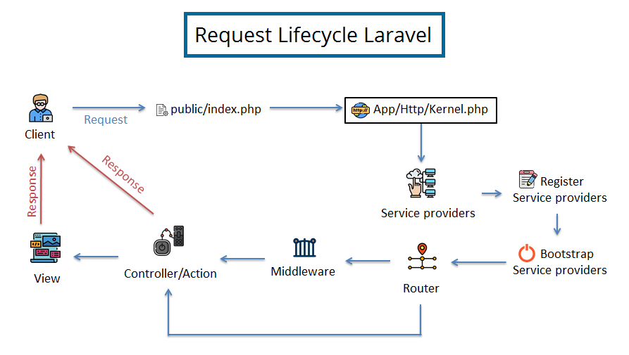
Laravel – so'rov hayot sikli

Slide 16
Xizmatlar konteyneri
Xizmatlar konteyneri (service container) – sinflarning bog'liqliklarini boshqarish va amalga oshirish vositasi.
Bog'liqlikni amalga oshirish quyidagicha: sinfning bog'liqliklari unga konstruktor (yoki setter metodlar) orqali ko'rsatiladi. Sinf yaratilganda yoki biror metodi chaqirilganda freymvork argumentlar ro'yxatini ko'radi va kerakli sinflar ekzemplyarlarini yaratadi va konstruktorga (metodga) uzatadi.
Bog'lashni amalga oshirishni belgilash uchun xizmat ko'rsatuvchilar sifatida maxsus App\Providers\AppServiceProvider.php provayderida (faylida) aniqlanishi kerak:
$this->app->bind(StudentRepositoryInterface::class, StudentRepository::class);

Slide 17
Fasadlar (Facades)
Laraveldagi deyarli barcha funksionalliklarni ishlatishga imkon beruvchi bir qancha yordamchi Fasad sinflar mavjud. Ular "statik" interfeysni taqdim qiladi. To'liq tarkibi bilan tanishish: https://laravel.com/docs/10.x/facades
<?php
namespace App\Http\Controllers;
use App\Http\Controllers\Controller;
use Illuminate\Support\Facades\Cache;
class UserController extends Controller
{
public function showProfile($id)
{
$user = Cache::get('user:' . $id);
return view('profile', ['user' => $user]);
}
}

Slide 18
Global yordamchilar (helpers)
Fasadlarga qo'shimcha ravishda Laravelning umumiy funksiyalari bilan aloqani osonlashtirish uchun global yordamchilar – helperlar mavjud. Masalan, view, response, url, config va h.k. Ularning to'liq tarkibi bilan tanishish: https://laravel.com/docs/10.x/helpers
use Illuminate\Support\Facades\Response;
Route::get('/users', function () {
return Response::json([
// ...
]);
});
Route::get('/users', function () {
return response()->json([
// ...
]);
});
return Illuminate\Support\Facades\View::make('profile');
return view('profile');

Slide 19
Laravel – dastlabki sozlash
.env faylida va /config/ papkasida ilovaning dastlabki sozlamalari joylashgan
APP_NAME=Laravel
APP_ENV=local
APP_KEY=base64:WNOGFq3sftzIeuzaJ9e6ZY8wVr5FO7WzkY5SOZ0Mj3U=
APP_DEBUG=true
APP_URL=http://localhost
LOG_CHANNEL=stack
DB_CONNECTION=mysql
DB_HOST=127.0.0.1
DB_PORT=3306
DB_DATABASE=laravel
DB_USERNAME=root
DB_PASSWORD=
APP_NAME="Talaba tizimi"
APP_ENV=local
APP_KEY=base64:WNOGFq3sftzIeuzaJ9e6ZY8wVr5FO7WzkY5SOZ0Mj3U=
APP_DEBUG=true
APP_URL=http://talaba.loc
LOG_CHANNEL=stack
DB_CONNECTION=mysql
DB_HOST=127.0.0.1
DB_PORT=3306
DB_DATABASE=test
DB_USERNAME=root
DB_PASSWORD=

Slide 20
Laravel - Route
Route – marshrutlar, URI va unga mos funksiyani aniqlash uchun ishlatiladi.
routes/web.php va routes/api.php fayllari orqali boshqariladi.
Masalan, "http://your-app.test/user" manzili uchun quyidagicha route aniqlash mumkin:
use App\Http\Controllers\UserController;
Route::get('/user', [UserController::class, 'index']);
Route metodlari:
Route::get($uri, $callback); Route::patch($uri, $callback);
Route::post($uri, $callback); Route::delete($uri, $callback);
Route::put($uri, $callback); Route::options($uri, $callback);
Bir nechta routelarga javob berish uchun match metodidan foydalaniladi:
Route::match(['get', 'post'], '/', function () {
//
});
Ixtiyoriy routelarga javob berish uchun any metodidan foydalaniladi:
Route::any('/', function () {
//
});

Slide 21
Laravel - Route
POST, PUT va DELETE ko'rinishida aniqlangan barcha marshrutlar uchun jo'natiladigan formalar CSRF token maydonini o'z ichiga olishi kerak, aks holda so'rov (request) bekor qilinadi.
<form method="POST" action="/profile">
@csrf
...
</form>
method direktivasi orqali formani jo'natish metodini alohida ko'rsatish mumkin:
<form action="/foo/bar" method="POST">
@method('PUT')
@csrf
...
</form>

Slide 22
Laravel - Route. Parametrlar
Routelarda parametrlarni ham aniqlash mumkin:
Route::get('user/{id}', function ($id) {
return 'User ' . $id;
});
Route::get('posts/{post}/comments/{comment}', function ($postId, $commentId) {
//
});
Agar marshrutda biror bog'liqliklar mavjud bo'lsa ularni doim parametrlardan oldin ko'rsatish kerak:
use Illuminate\Http\Request;
Route::get('/user/{id}', function (Request $request, $id) {
return 'User '.$id;
});

Slide 23
Laravel - Route. Parametrlar
Parametrlar majburiy bo'lmasa '?' belgisi ishlatiladi, shuningdek metodda kelishuv bo'yicha qiymatni ham aniqlash kerak:
Route::get('user/{name?}', function ($name = null) {
return $name;
});
Route::get('user/{name?}', function ($name = 'Karim') {
return $name;
});
Route::get('user/{name?}', [UserController::class, 'index']);
use Illuminate\Http\Request; class UserController extends Controller
{
public function index(Request $request, $name = "Karim")
{
// ...
}
}

Slide 24
Laravel - Route. Parametrlarga cheklovlar
Parametrlar qiymatlariga regulyar ifodalar yoki maxsus metodlar orqali cheklov qo'yish mumkin.
Route::get('/user/{name}', function (string $name) {
// ...
})->where('name', '[A-Za-z]+');
Route::get('/user/{id}', function (string $id) {
// ...
})->where('id', '[0-9]+');
Route::get('/user/{id}/{name}', function (string $id, string $name) {
// ...
})->where(['id' => '[0-9]+', 'name' => '[a-z]+']);

Slide 25
Laravel - Route. Parametrlarga cheklovlar
Parametrlar qiymatlariga regulyar ifodalar yoki maxsus metodlar orqali cheklov qo'yish mumkin.
Route::get('/user/{id}/{name}', function (string $id, string $name) {
// ...
})->whereNumber('id')->whereAlpha('name');
Route::get('/user/{name}', function (string $name) {
// ...
})->whereAlphaNumeric('name');
Route::get('/user/{id}', function (string $id) {
// ...
})->whereUuid('id');
Route::get('/category/{category}', function (string $category) {
// ...
})->whereIn('category', ['movie', 'song', 'painting']);

Slide 26
Laravel - Route. Nomlash
Routelarga nom berish uchun name() metodidan foydalaniladi:
Route::get('user/profile', [UserProfileController::class, 'show'])->name('profile.get');
Route::post('user/profile', function () {
//
})->name('profile.post');
route() metodi yordamida routelarga nomi orqali murojaat qilish mumkin:
$url = route('profile'); // URL hosil qilish...
return redirect()->route('profile'); // Yo'naltirish (redirect) qaytarish...
Parametrlarni ham route() metodi orqali jo'natish mumkin:
Route::get('user/{id}/profile', function ($id) {
//
})->name('profile');
$url = route('profile', ['id' => 1]); // /user/1/profile
$url = route('profile', ['id' => 1, 'photos' => 'yes']); // /user/1/profile?photos=yes

Slide 27
Laravel - Route. Guruhlash
Routelarni guruhlash uchun Route::group metodidan foydalaniladi. Guruhlash biror maqsadga asoslanishi kerak:
Route::middleware(['first', 'second'])->group(function () {
Route::get('/', function () {
// first va second Middleware lardan foydalanadi
});
Route::get('user/profile', function () {
// first va second Middleware lardan foydalanadi
});
});
use App\Http\Controllers\OrderController;
Route::controller(OrderController::class)->group(function () {
Route::get('/orders/{id}', 'show');
Route::post('/orders', 'store');
});

Slide 28
Laravel - Route. Guruhlash
Routelarni guruhlash uchun Route::group metodidan foydalaniladi. Guruhlash biror maqsadga asoslanishi kerak:
Route::prefix('admin')->group(function () {
Route::get('users', function () {
// "/admin/users" URL ko'rinishida
return "admin/users";
});
}); Route::name('admin.')->group(function () {
Route::get('users', function () {
// Routelarga "admin.users" nom ulanadi
return "admin.users nomli route";
})->name('users');
});
Route::group(['prefix' => 'student'], function () {
Route::get('all', [StudentController::class, 'index']);
Route::get('by-course', [StudentController::class, 'by_course']);
});
Route::group(['prefix' => 'admin', 'middleware' => 'is.admin', 'as' => 'admin.'], function () {
Route::get('/', [AdminDashboardController::class, 'index'])->name('dashboard');
Route::resource('teachers', AdminTeacherController::class);
});
php artisan route:list buyrug'i orqali ro'yxatdan o'tgan routelarni ko'rish mumkin

Slide 29
Laravel - Controller
Controllerlar app/Http/Controllers papkasida joylashgan. Controllerni yaratish uchun artisan make:controller buyrug'idan foydalaniladi.
php artisan make:controller UserController
Namuna:
<?php namespace App\Http\Controllers; use App\Models\User;
use Illuminate\View\View;
class UserController extends Controller
{
public function show(string $id): View
{
return view('user.profile', [
'user' => User::findOrFail($id)
]);
}
}
Route faylida:
use App\Http\Controllers\UserController;
Route::get('/user/{id}', [UserController::class, 'show']);

Slide 30
Laravel - Resource Controller
Resource Controller – CRUD amallar uchun metodlari mavjud bo'lgan controller tushuniladi.
Artisan orqali yaratish: php artisan make:controller PhotoController --resource [--model=Photo]
Routeda registratsiya qilish:
use App\Http\Controllers\PhotoController;
Route::resource('photos', PhotoController::class);
Bunda quyidagi resurslar yaratiladi:
Route::resources([
'photos' => PhotoController::class,
'posts' => PostController::class,
]);
Metod | URI | Controller metodi | Route nomi
GET | /photos | index | photos.index
GET | /photos/create | create | photos.create
POST | /photos | store | photos.store
GET | /photos/{photo} | show | photos.show
GET | /photos/{photo}/edit | edit | photos.edit
PUT/PATCH | /photos/{photo} | update | photos.update
DELETE | /photos/{photo} | destroy | photos.destroy

Slide 31
Laravel – Chaqiriluvchi kontroller
Kontrollerni faqat bitta amal bilan yaratish kerak bo'lganda __invoke() metodidan foydalanish mumkin.
Artisan buyruq: php artisan make:controller ShowProfile –invokable
Marshrut: Route::get('user/{id}', ShowProfile::class);
Kontroller:
namespace App\Http\Controllers;
use App\User;
use App\Http\Controllers\Controller;
class ShowProfile extends Controller
{
public function __invoke($id)
{
return view('user.profile', ['user' => User::findOrFail($id)]);
}
}

Slide 32
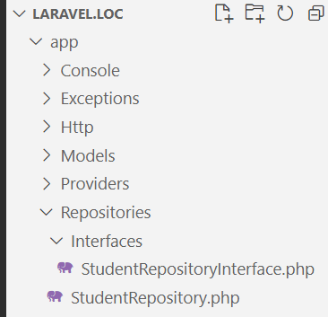
Namuna
Kontrollerni yaratish:
php artisan make:controller StudentController –r
Routega ulash:
use App\Http\Controllers\StudentController; Route::resource('students', StudentController::class);
Repozitoriy yaratish:
1. app papkasini ichida Repositories papkasini yaratish
2. Repositories papkasini ichida Interfaces papkasini va uning ichida StudentRepositoryInterface.php faylini yaratish
3. Repositories papkasini ichida StudentRepository.php yaratish

Slide 33
Namuna
StudentRepositoryInterface.php fayli kodi:
<?php
namespace App\Repositories\Interfaces;
interface StudentRepositoryInterface
{
public function allStudents();
public function storeStudent($data);
public function findStudent($id);
public function updateStudent($data, $id);
public function destroyStudent($id);
}

Slide 34
Namuna
StudentRepository.php fayli kodi:
<?php
namespace App\Repositories;
use App\Repositories\Interfaces\StudentRepositoryInterface;
use App\Models\Student;
class StudentRepository implements StudentRepositoryInterface
{
protected $talabalar = [];
public function __construct()
{
$this->talabalar = [
["name" => "alimov", "kurs" => 2],
["name" => "alimova", "kurs" => 2],
["name" => "karimov", "kurs" => 3],
["name" => "nishonov", "kurs" => 1],
];
}
public function allStudents()
{
return $this->talabalar;
return Student::latest()->paginate(10);
}
public function storeStudent($data)
{
$this->talabalar[] = $data;
return $this->talabalar;
return Student::create($data);
}
public function findStudent($id)
{
return Student::find($id);
}
public function updateStudent($data, $id)
{
$category = Student::where('id', $id)->first();
$category->name = $data['name'];
$category->slug = $data['slug'];
$category->save();
}
public function destroyStudent($id)
{
$category = Student::find($id);
$category->delete();
}
}

Slide 35
Namuna
Interfeys va sinfni bog'lash app/Providers/AppServiceProvider.php faylida amalga oshiriladi:
use App\Repositories\Interfaces\StudentRepositoryInterface;
use App\Repositories\StudentRepository;
…
public function register(): void
{
$this->app->bind(StudentRepositoryInterface::class, StudentRepository::class);
}
…

Slide 36
Namuna
Kontroller fayl quyidagicha:
<?php
namespace App\Http\Controllers;
use App\Repositories\Interfaces\StudentRepositoryInterface;
use Illuminate\Http\Request;
use Illuminate\Http\RedirectResponse;
class StudentController extends Controller
{
protected $students;
public function __construct(StudentRepositoryInterface $students)
{
$this->students = $students;
}
public function index()
{
$students = $this->students->allStudents();
return $students;
}
public function create()
{
$students = $this->students->storeStudent(["name" => "Sultonov", "kurs" => 2]);
return $students;
}
public function store(Request $request): RedirectResponse
{
$name = $request->name;
// saqlash ishlari amalga oshirish
return redirect('/users');
}
…

Slide 37
Savollar?

